Slide 1




NEXT GEN EMPLOYABILITY PROGRAM
Creating a future-ready workforce
Team Members
College Name
Student Name :S.A.Kavya Sri
Student ID : au814721104028
SRM TRP Engineering College

Slide 2

CAPSTONE PROJECT SHOWCASE
Project Title
Notes Sharing Web Application using Django Framework
Abstract | Problem Statement | Project Overview | Proposed Solution | Technology Used | Modelling & Results | Conclusion

Slide 3
Abstract
NoteSharing is a versatile web platform crafted with Django, revolutionizing collaborative note-sharing. Beyond standard features like user authentication and real-time collaboration, NoteSharing prioritizes data security and privacy. Its user-centric design allows for effortless note creation, organization, and sharing, while advanced sharing controls ensure sensitive information remains protected. With NoteSharing, teams and individuals alike can harness the power of collaborative note-taking, fostering productivity and innovation.
Source :

Slide 4
Problem Statement
Current note-sharing platforms lack seamless collaboration features, robust data security, and user-friendly interfaces. Users struggle to manage notes across different sources efficiently, hindering productivity and knowledge exchange. There is a need for a comprehensive solution that combines collaborative note-sharing with advanced security measures and intuitive interfaces to address these challenges effectively.
Source :

Slide 5
Project Overview
NoteSharing is a collaborative note-sharing platform developed using the Django framework. It aims to streamline the process of creating, organizing, and sharing notes among users. With features like user authentication, real-time collaboration, and robust data security measures, NoteSharing enhances productivity and facilitates knowledge exchange. Its intuitive interface and advanced sharing controls empower users to manage notes effectively while ensuring data privacy.
Source :

Slide 6
Proposed Solution
.
NoteSharing, a Django-based web application, offers seamless collaborative note-sharing with user-friendly interfaces, real-time collaboration tools, and robust data security measures. Its intuitive design empowers users to create, organize, and share notes efficiently, fostering productivity and knowledge exchange.
Source :

Slide 7


Technology Used
Front-end
Back-end
Source :

Slide 8
Modelling & Results
NoteSharing utilized Django's MVC architecture, incorporating user authentication, note storage, and real-time collaboration features. The platform successfully passed performance tests, ensuring scalability and responsiveness. User feedback confirmed its user-friendly interface and collaborative capabilities, leading to improved productivity and knowledge exchange. Ongoing updates are planned to enhance the platform further based on user input.
Source :

Slide 9
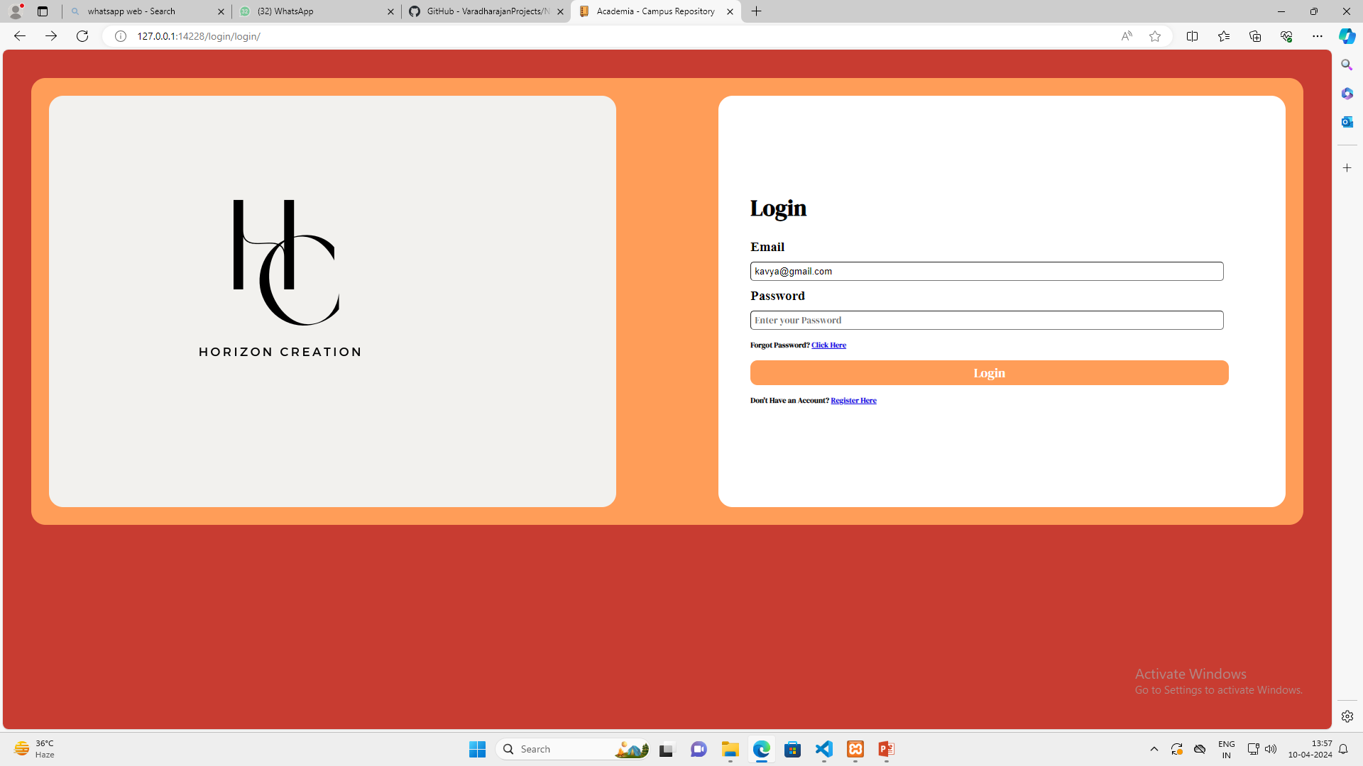
Homepage

Slide 10
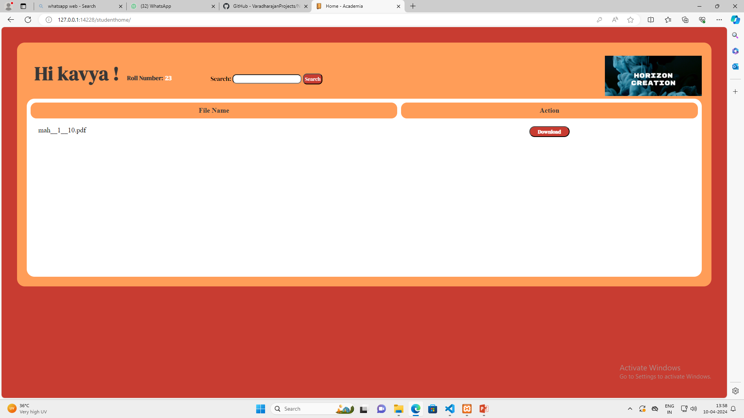
Student page

Slide 11
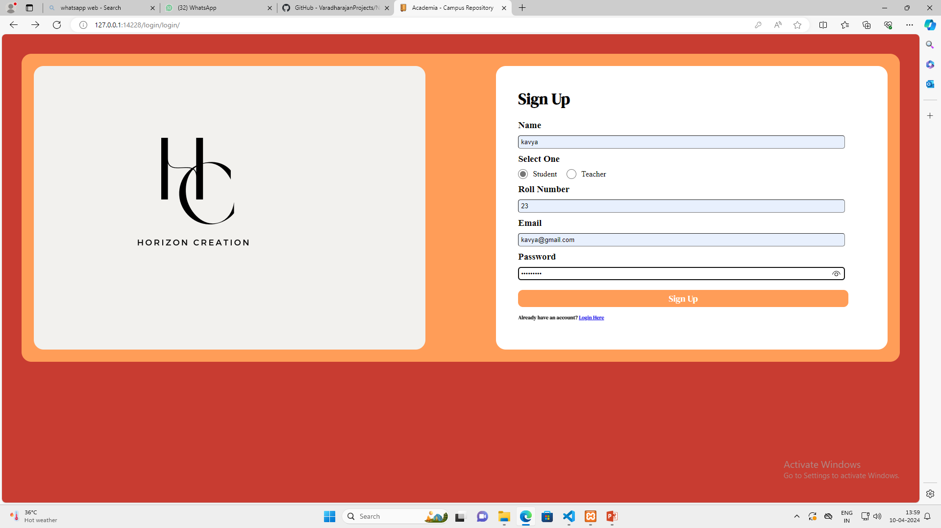
Student login

Slide 12
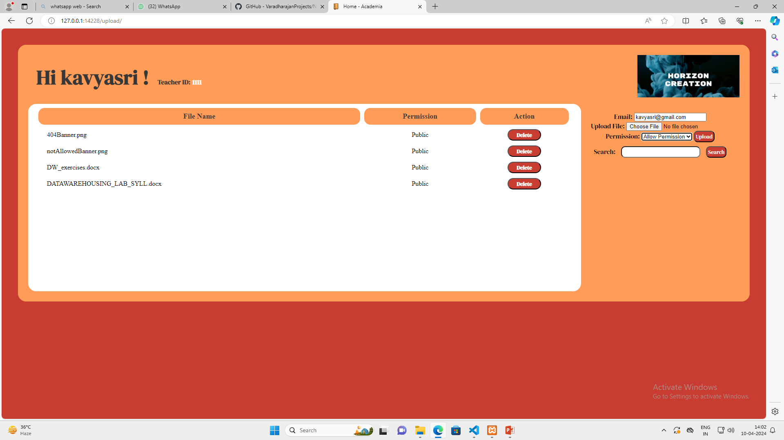
Teachrer page

Slide 13
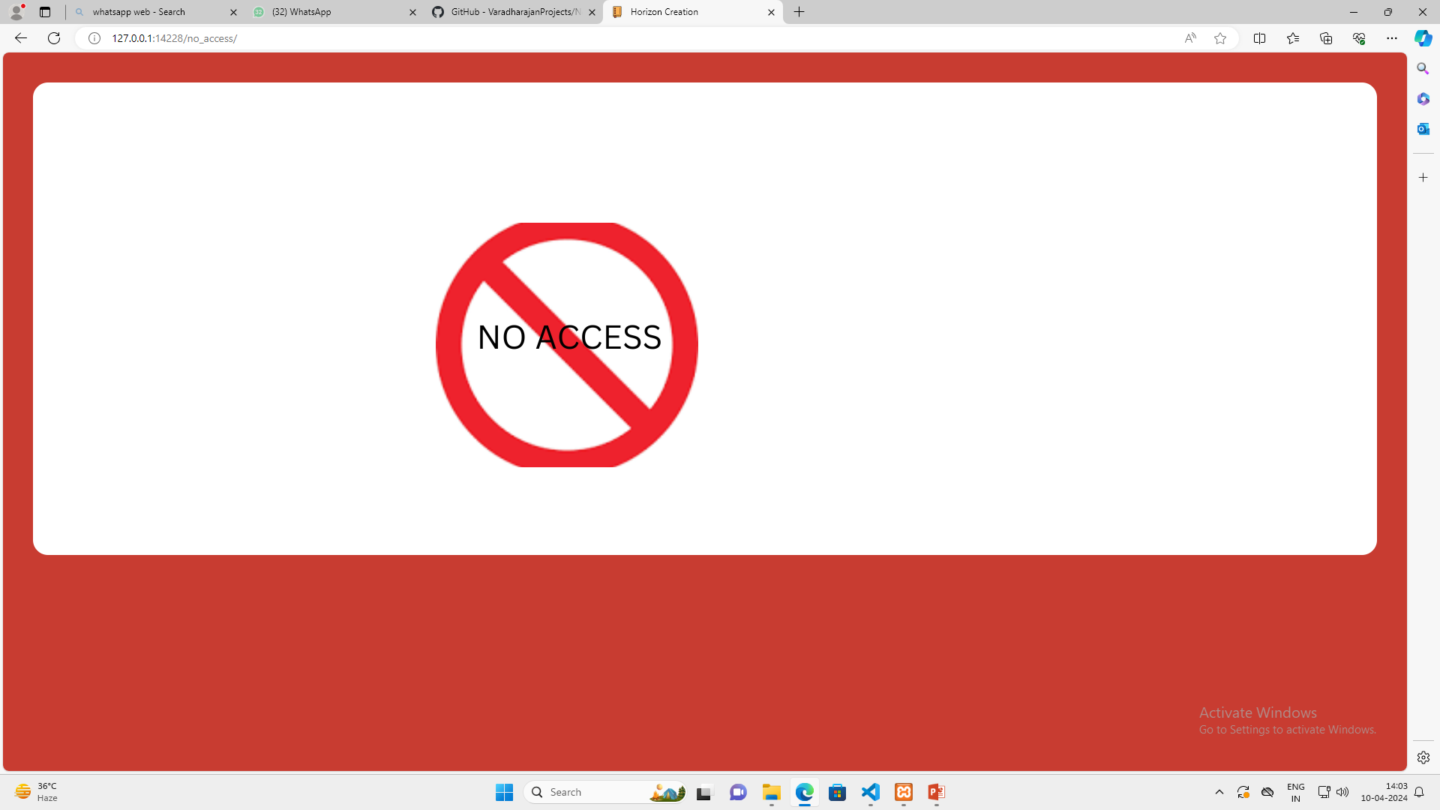
No access

Slide 14
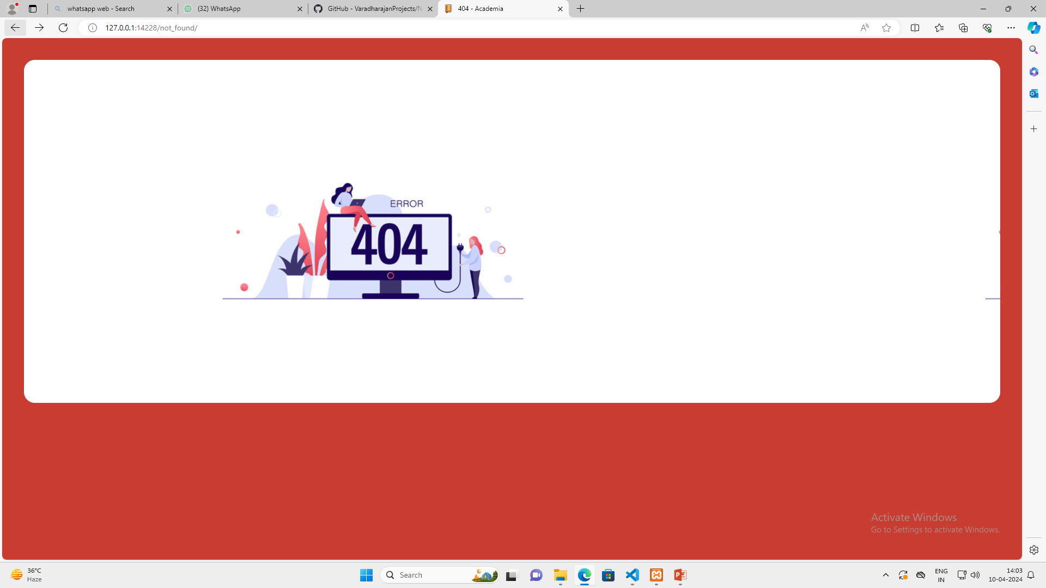
Not found

Slide 15
Future Enhancements:
Enhanced Collaboration Features: Introduce additional collaboration tools such as comments, annotations, and version control to facilitate more comprehensive collaboration on notes.
Mobile Optimization: Optimize the platform for mobile devices, ensuring a seamless user experience across various screen sizes and devices, thereby increasing accessibility.
Integration with Third-Party Services: Implement integrations with popular productivity tools such as Google Drive, Dropbox, and Microsoft Office for seamless import/export functionality and extended collaboration options.
Advanced Search and Organization: Enhance search functionality and note organization capabilities by implementing features such as advanced filters, tagging, and sorting options to streamline note retrieval and management.

Slide 16
Conclusion
In conclusion, NoteSharing emerges as a comprehensive solution for collaborative note-sharing, leveraging the capabilities of the Django framework. With its intuitive interface, real-time collaboration features, and robust security measures, NoteSharing streamlines the process of creating, organizing, and sharing notes among users. The platform's success lies in its ability to enhance productivity and facilitate seamless knowledge exchange while prioritizing data security and user experience. Moving forward, continued enhancements and adaptations will ensure NoteSharing remains at the forefront of collaborative note-sharing, meeting the evolving needs of individuals, teams, and organizations in the digital age.
Source :

Slide 17
Thank You!
Notes:
Thank You !!

